Slide 1
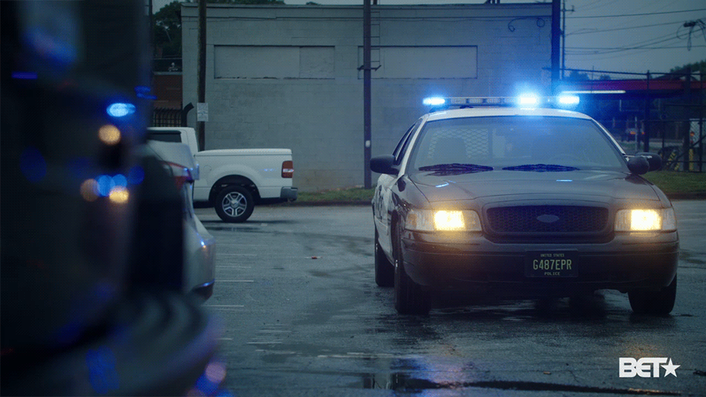
Informatics 201 Final Project
Crime Investigation Department (CID) Members:
Anhad Dhillon
Divit Jawa
Kartik Aryan
Saasha Mor

Slide 2
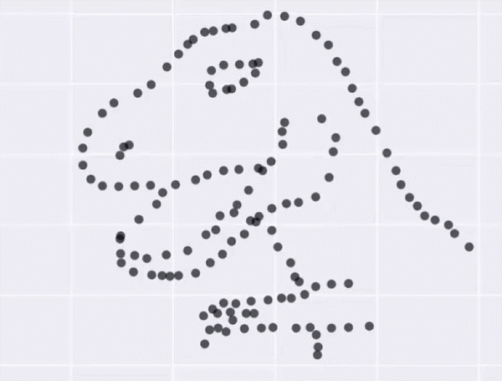
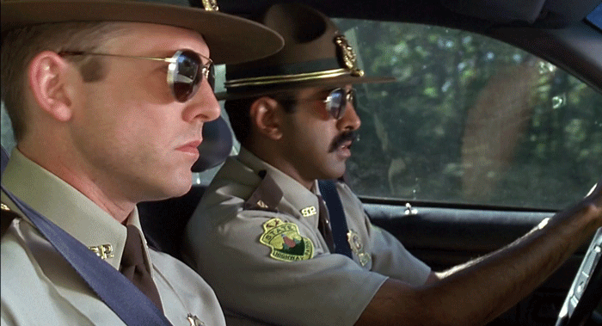
Project Description:
We’ll be working with the “​Seattle police department 911 response dataset​”. This data set provides a plethora of data to work with which allows us to answer many questions and draw constructive conclusions about crime in Seattle. Our final goal is to create a shiny app to comprehensively answer questions about the safety of people in Seattle

Slide 3

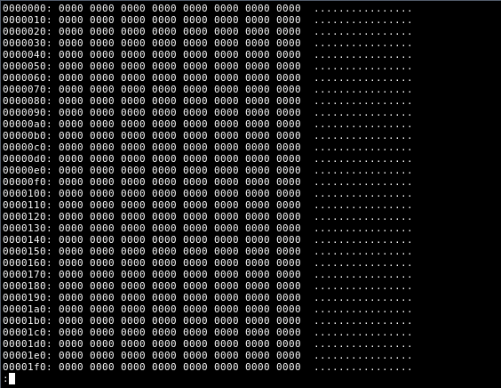
Dataset Background:
This data set contains data about 911 calls made and their time, coordinates and grouping/subgrouping about the type of complaint. The data ranges from 2010 to 2017.
It makes the data generated by the City of Seattle openly available to the public for the purpose of increasing transparency, accountability and comparability; promoting economic development and research; and improving internal performance management. (“City of Seattle Open Data Portal.” ​ Seattle​ ,

Slide 4

Target Audience:
People who shifted to Seattle that need to find safe areas to live
Students
Homeless people
UWPD

Slide 5

Questions of Interest:
Which area of Seattle has the most density of crime?
Which type of crime is prevalent in a particular area in Seattle?
How does crime rate correlate to a particular day of the week?
How does crime correlate to a particular time during the day?
Which type of crime is the most prevalent on the UW campus?
How do calls for assaults at the UW campus compare to those across the rest of Seattle?
What kind of crimes(noise complaints, liquor violations and threats and harassments) are prevalent on the Greek row at UW?

Slide 6

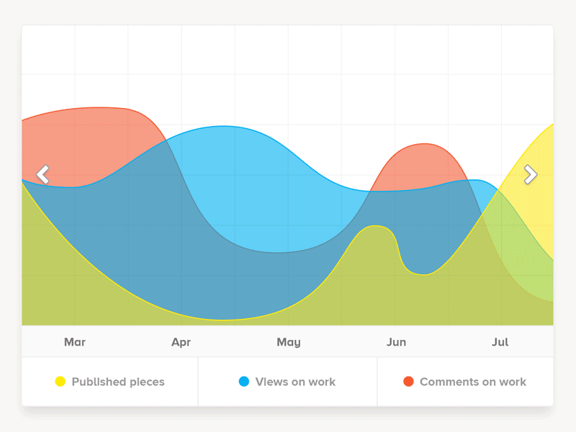
Project Format:
Our final project would be a Shiny app, which allows for most versatility and flexibility in terms the data we can display.
Reading Data:
We will be obtaining our data with a downloaded CSV file which has data till the year 2017.

Slide 7



Statistical Questions:
What percentage of crimes were “ASSAULTS”?
Which district had the least crime rate in 2014?
Which district had the highest crime rate overall?
How many thefts were reported throughout the years(entire dataset)?
How many ‘FALSE ALARMS’ were there in 2016?
How has crime rate changed before and after legalization of Marijuana?

Slide 8
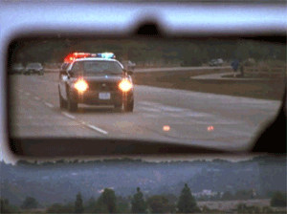
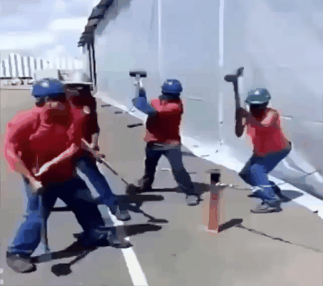
Libraries Used:
ggplot
Plotly
Shiny
httr
Anticipated Challenges:
#teamWork
Data collected might be outdated and may not reflect accurate results for the users today
Visualizing data before performing huge operations to answer our questions

Slide 9


